Slide 1
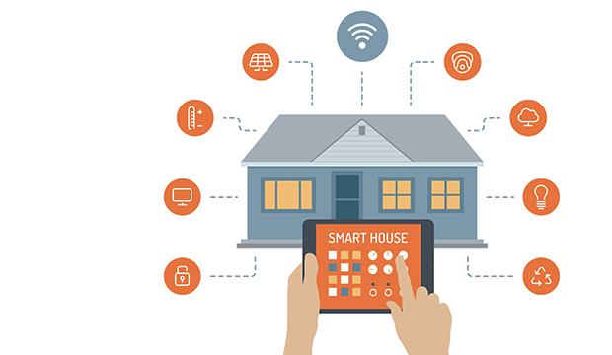
Next generation of homes
Chung Poon
Notes:
My presentation today is

Slide 2

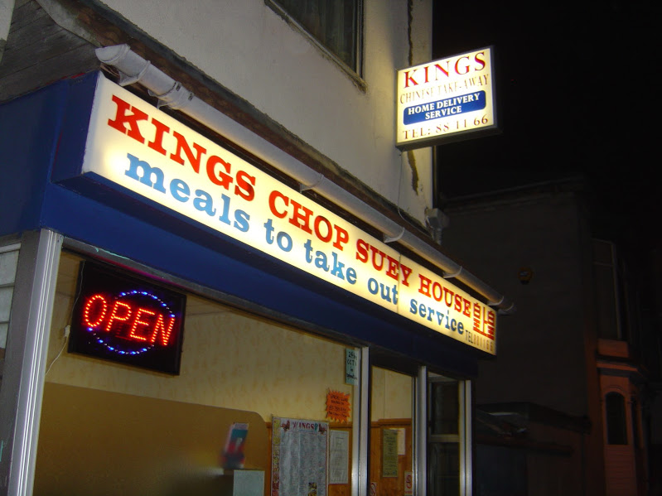
A Brief History
Notes:
Back when I was 14
Family business Chinese Takeaway
works long hours
In the north east, where the average temp is 3c
Arrives to a freezing cold home
Surely I can do something

Slide 3
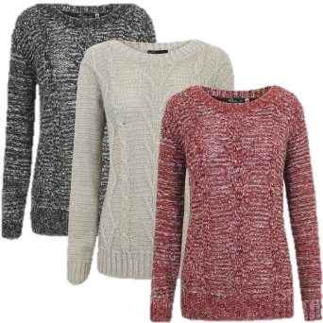
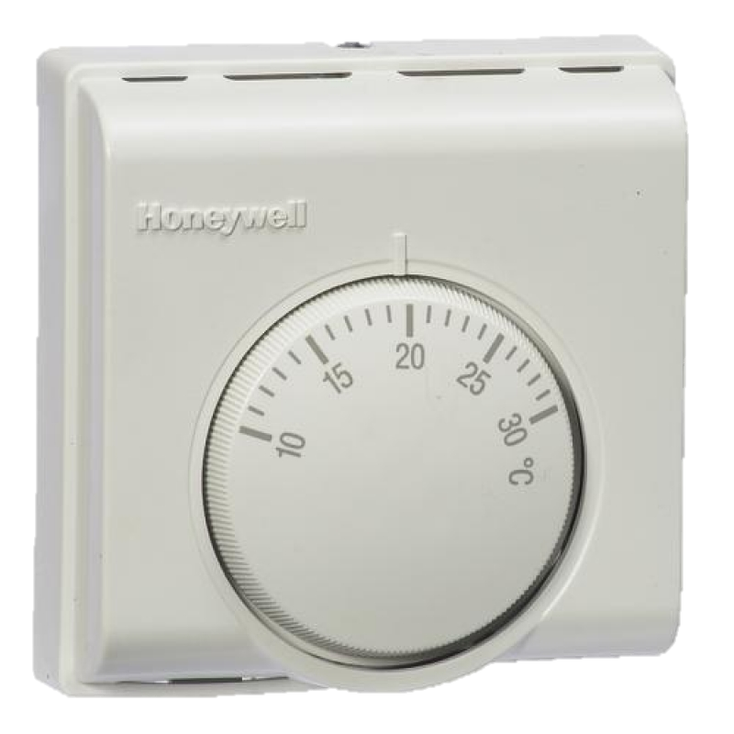
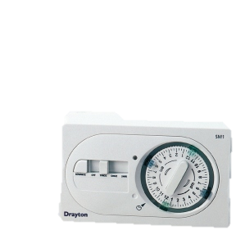
What Can I Do?
Source: DECC 2012
Notes:
First I investigated different type of technology
Timer - Irregular working hours
Thicker Jumper?
Thermostat - Keep the heating on? Wasting energy –Turn down 2C to 18c can save Britain 55TWh/yr

Slide 4
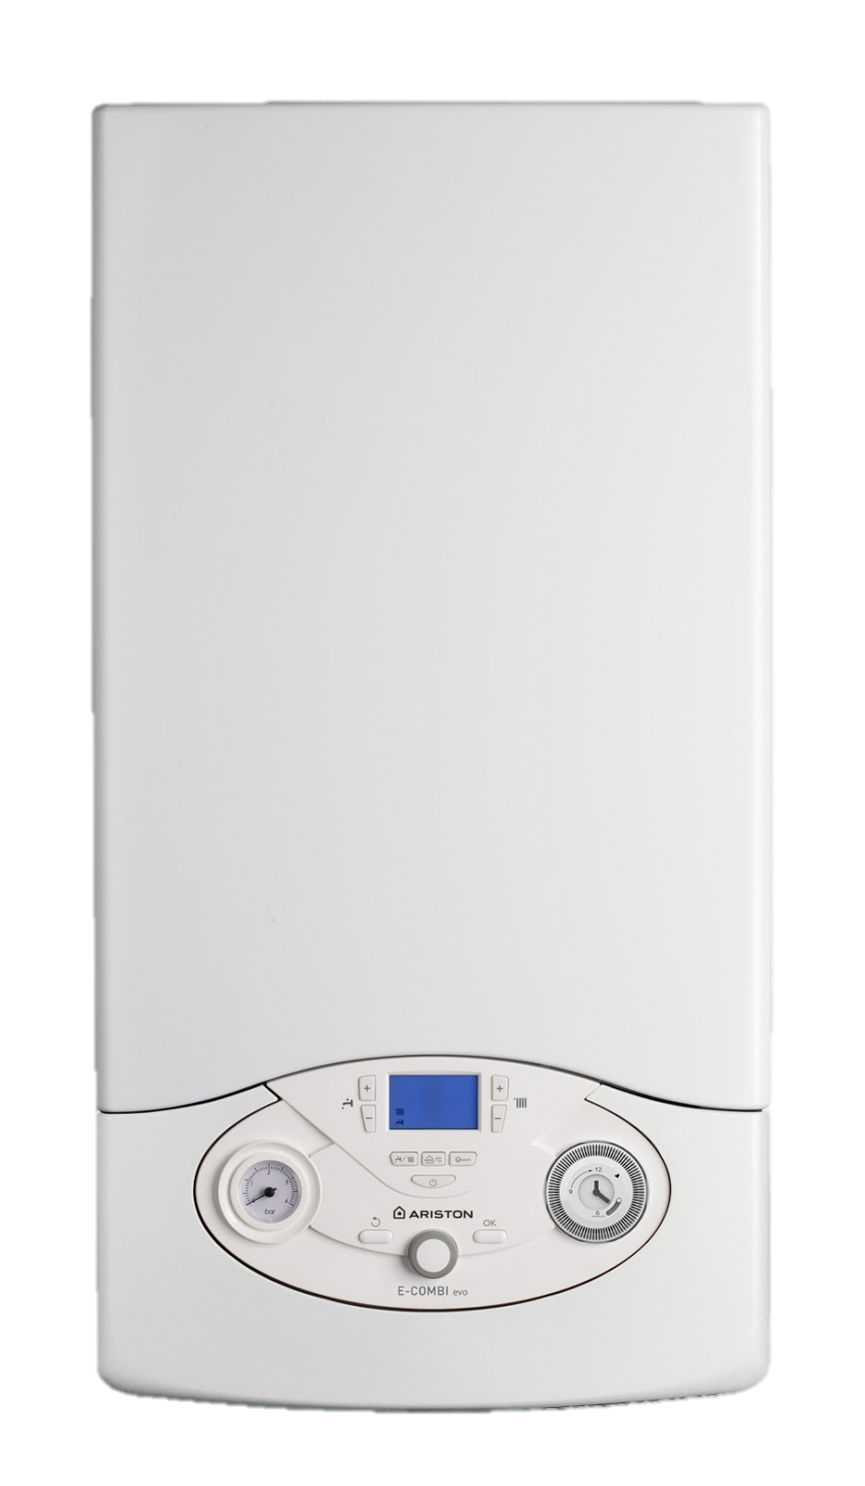

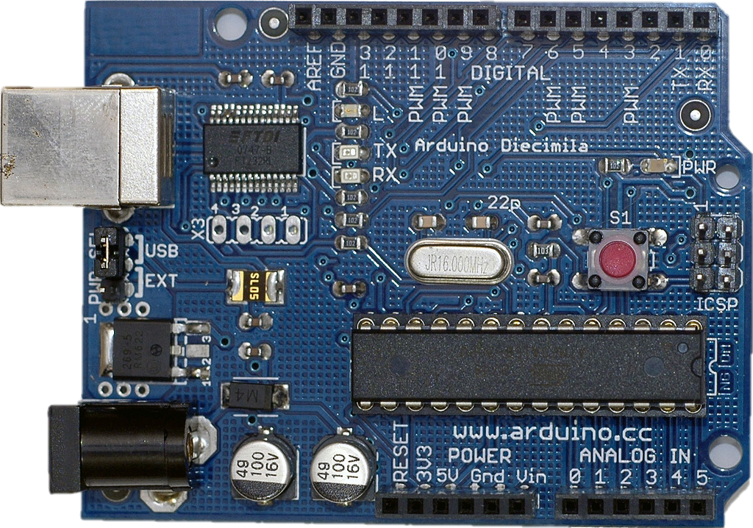
My Solution
+
Notes:
My first attempt at solving this problem
Connecting the boiler controls to a microcontroller
Explain Arduino and point
The microcontroller has an added module on top to connect it to the internet

Slide 5
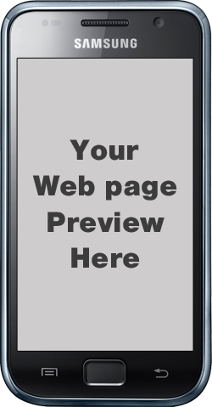
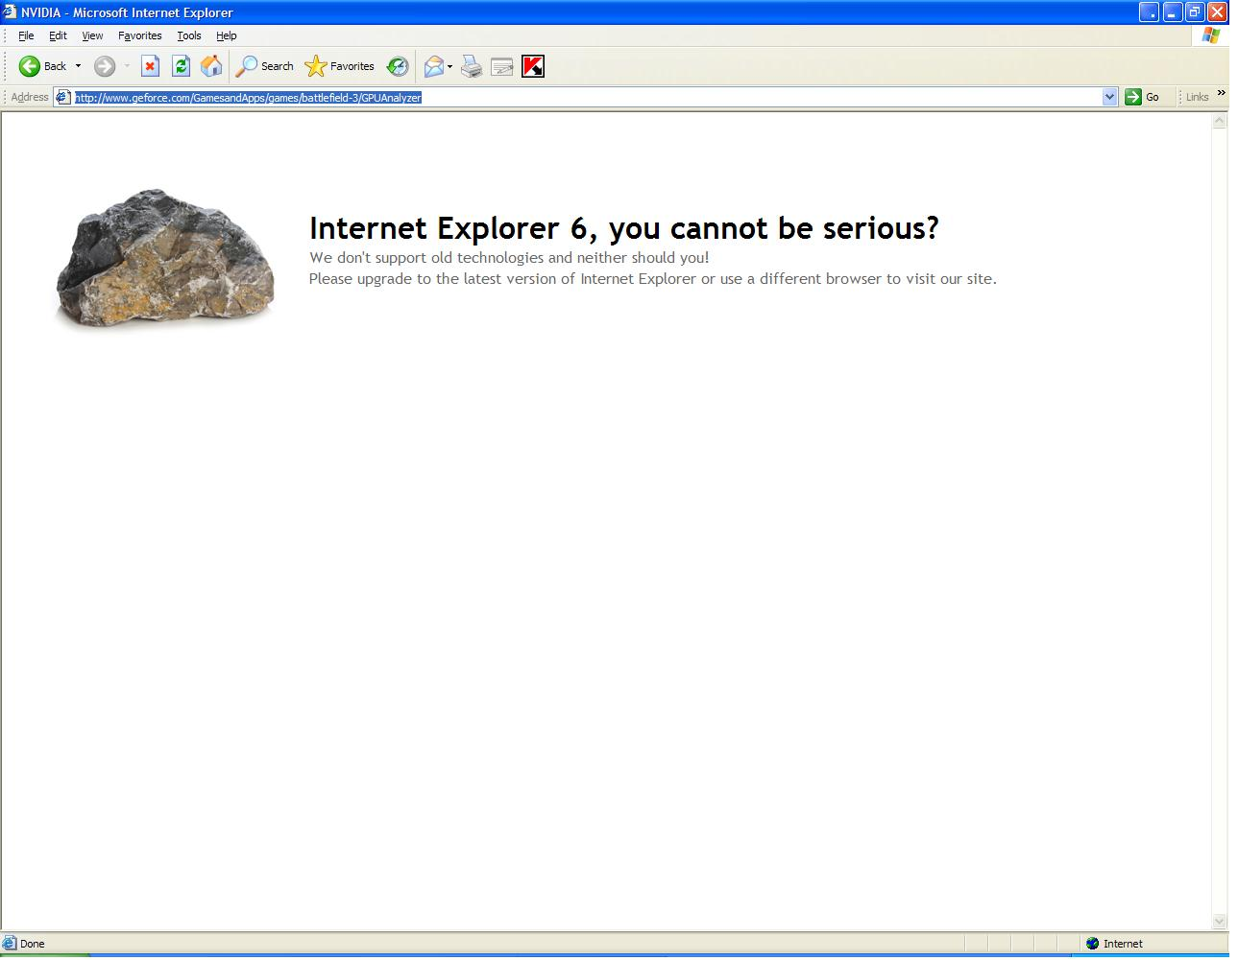
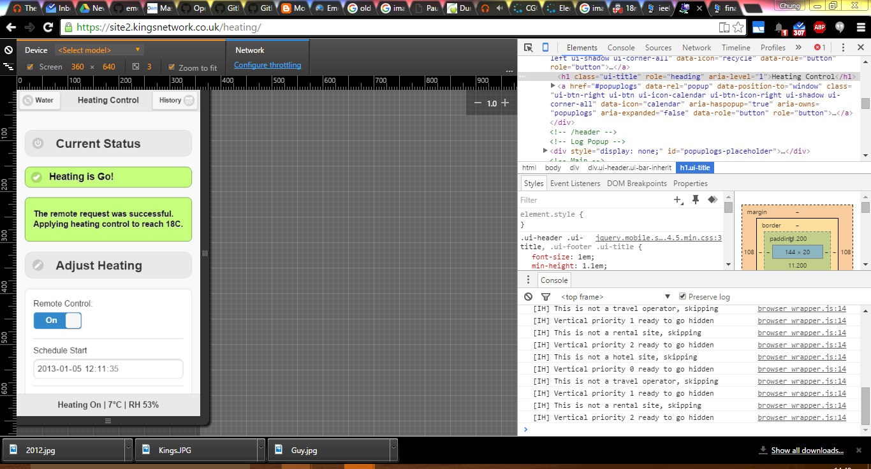
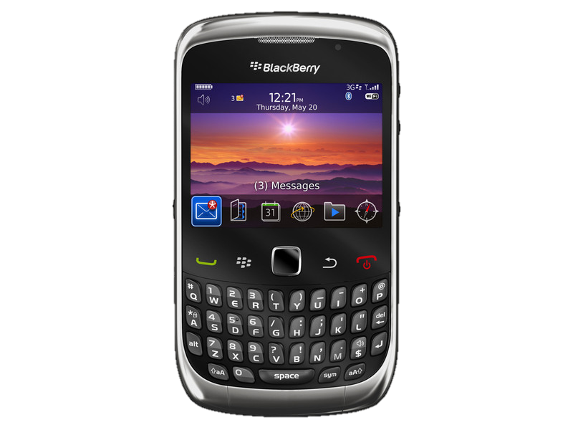
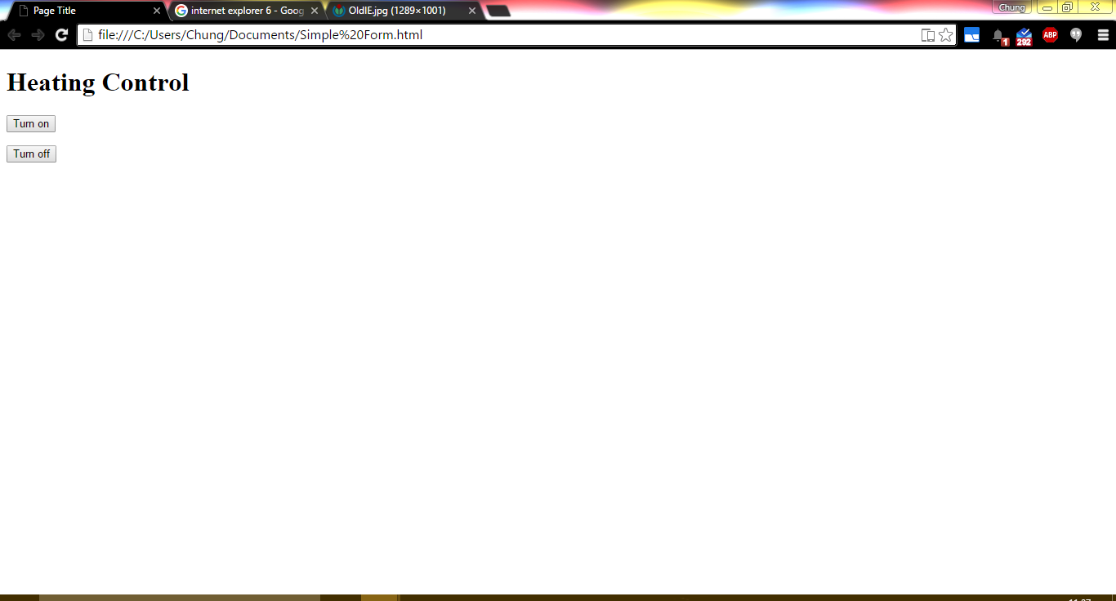
Result!
Notes:
It was a success!
Mum can enjoy coming back to a warm home
Over the years
As technology moved on
Can tell from the phone
Improvements
Thermostat
Adaptable Time-aware

Slide 6



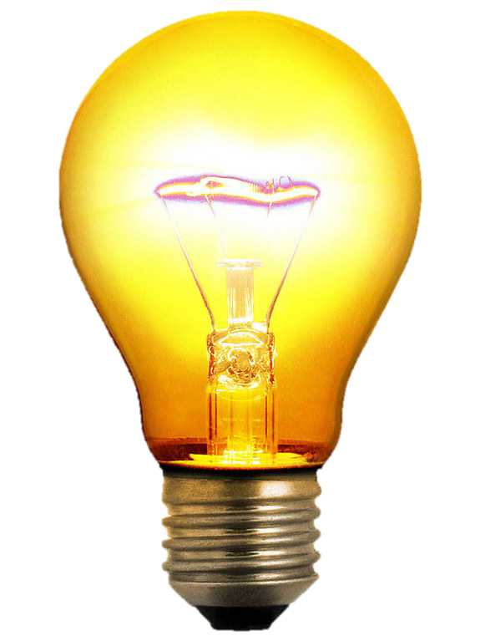

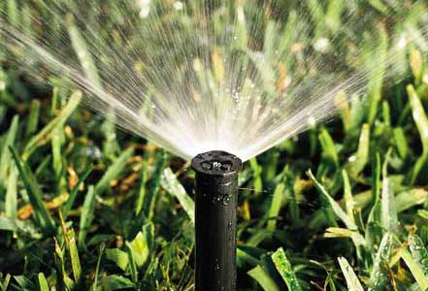

More Data! More Control!
Notes:
Apart from the temperature controlling the heating,
Why stop there?
Humidity
Who’s home
Electricity usage
--know that my electric shower very energy hungry
What can we do with all this data?
(as expected)
Appliances like TV switched off when no one is home
Controlled light – as above but can also switch on randomly
Eureka!!
Sprinkler!
…from the humidity
----All powered by data
But then I ran into trouble
Not enough capacity

Slide 7
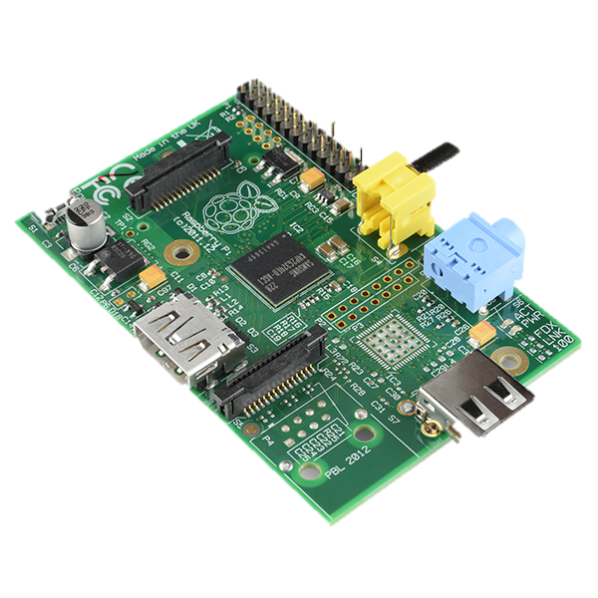
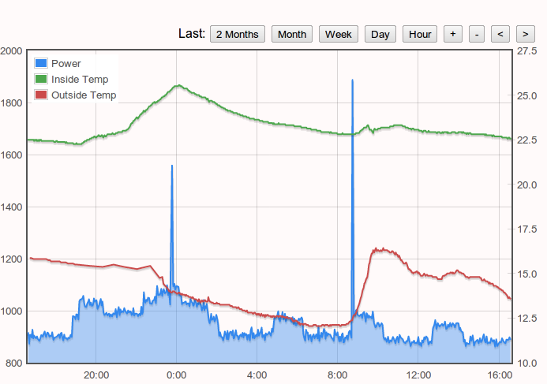
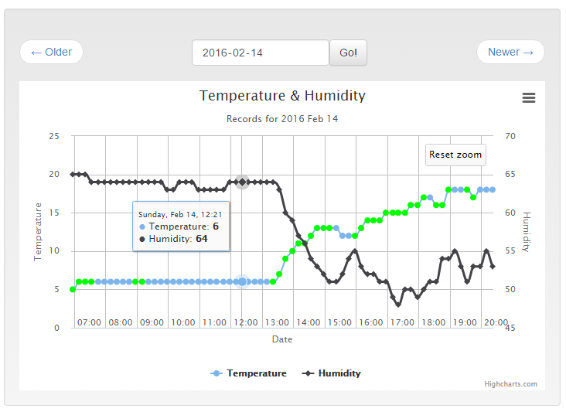
Handling more Data
Notes:
I needed a way of storing and processing the waves of numbers streaming in, both by the machine.
They say a picture is worth 1000 words. They are right!
Visualisation was key to my sprinkler problem

Slide 8
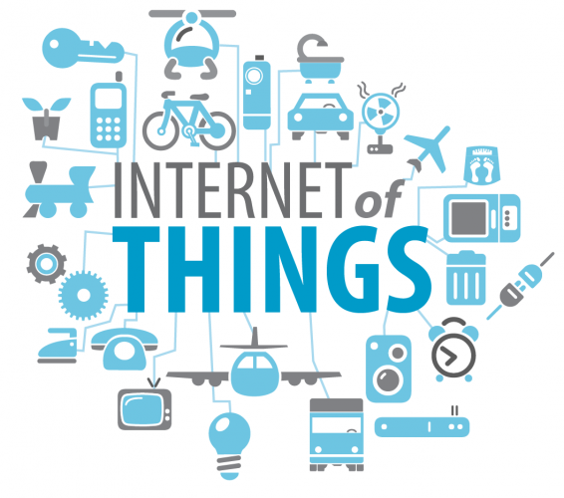
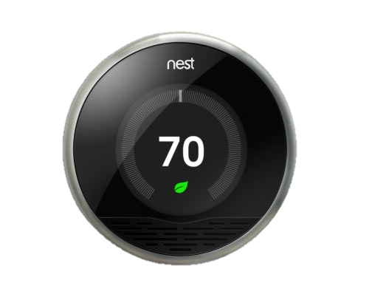
Was I Alone?
Notes:
NO, commercial opportunities!
Nest – just like my thermostat, it can be controlled remotely
Also does machine learning so that temp habits and schedules are automated
We have all heard of it
Introduce IoT
The Internet of Things (IoT) is the network of physical objects—devices, vehicles, buildings and other items embedded with electronics,software, sensors, and network connectivity—that enables these objects to collect and exchange data.^{[1]} The Internet of Things allows objects to be sensed and controlled remotely, efficiently and accurately.
Communities built around exploiting the many embedded system already collecting data from sensors in every part of life.
So much data, we need a common way to share this

Slide 9
Internet of Things
HTTP
MQTT
Notes:
Need a way to exchange data between multiple devices effectively, across different programming languages, OS, platforms.
Interoperability
Just like People to people with HTTP on the world wide web
Found
Machine
MQTT – Message Queuing Telemetry Transport
MQTT keeps bandwidth at an absolute minimum and deals with unreliable networks without complex error handling and a huge implementation effort.
Embedded computers and telemetry existed for many years now…
(maybe reference my surveying times)
What has changed?
Mentality – Working groups like IBM, (Sierra Wireless?)
How is it different to before?

Slide 10

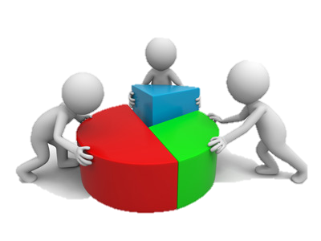
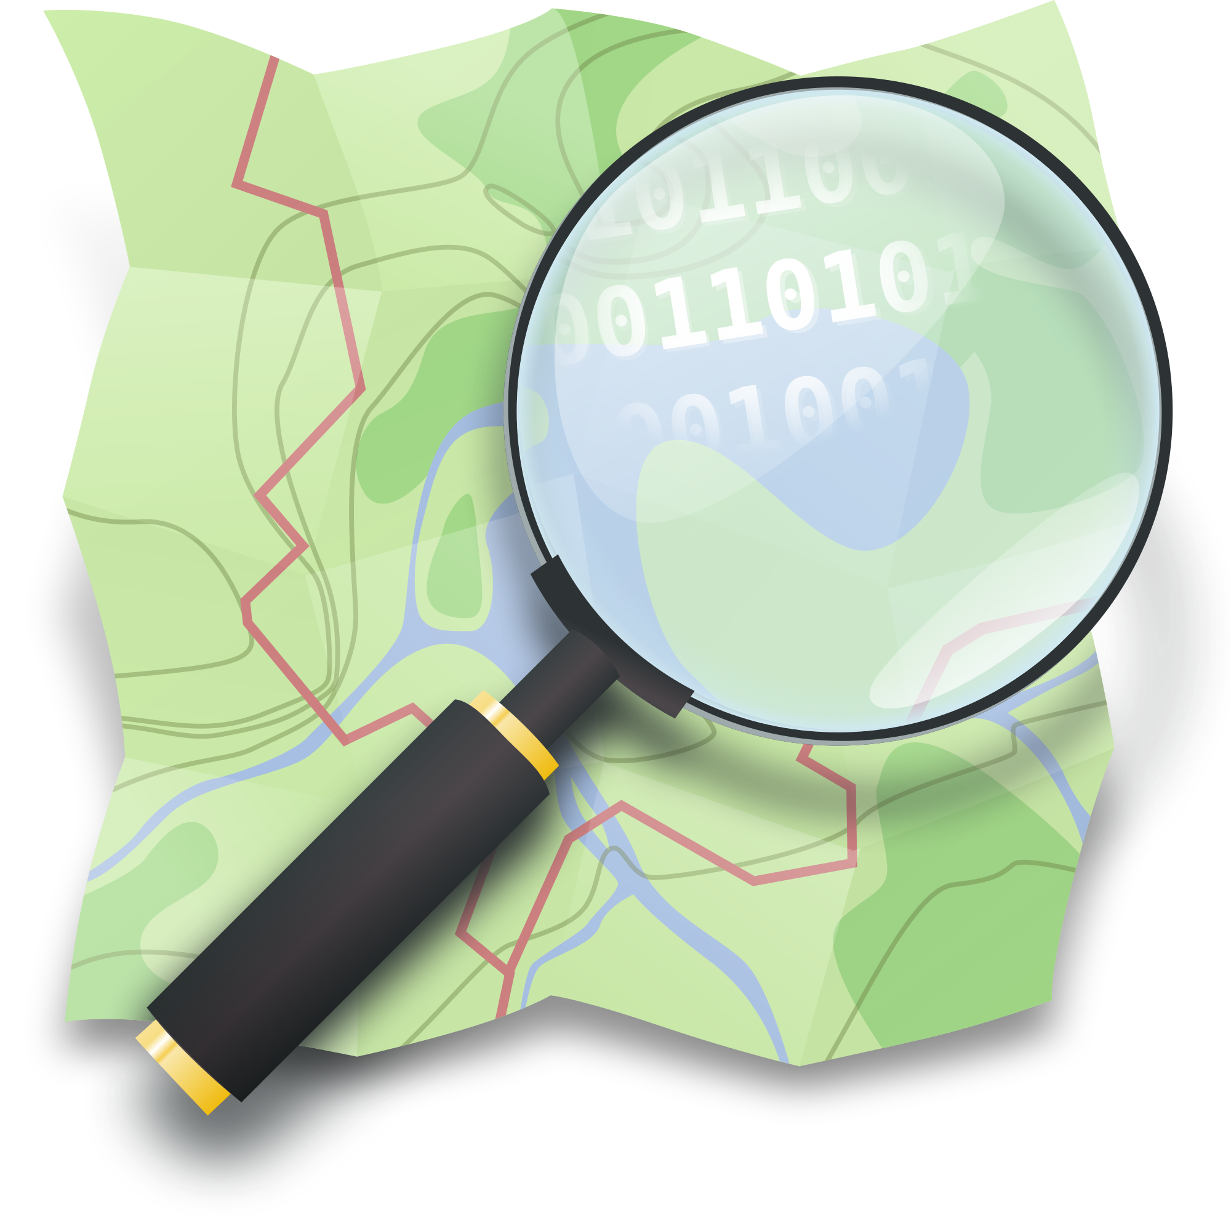
Big Data
Notes:
Connect data together
The movement
Open Government Data
→Postcode
Open Street Map
Data sharing, non-application specific
AS Opposed to data contained

Slide 11

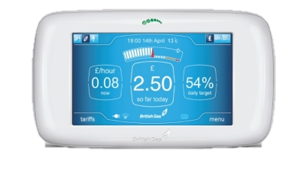
Smart Meters
Notes:
Every home in the UK will have one of these installed by 2020.
What is it?
Send your energy usage to your energy supplier directly, who can then predict how much used.
Cheaper
Greener
Feed in tariff
More flexible

Slide 12
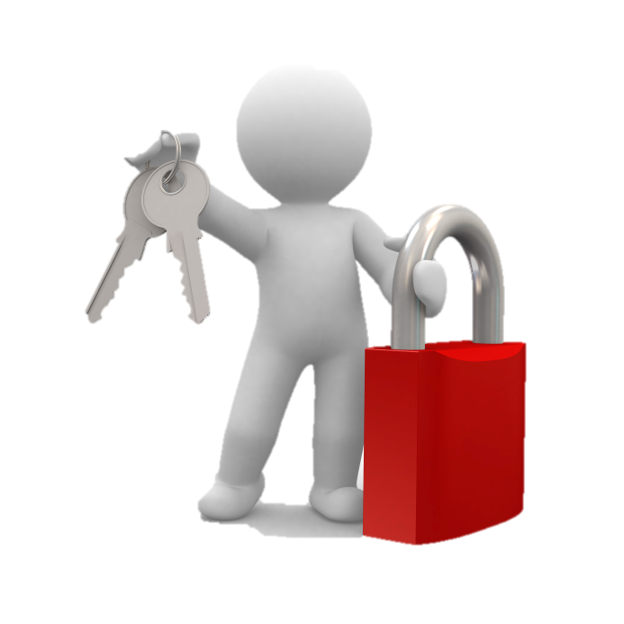

Security and Privacy
Notes:
With these embedded systems living close to us, it also brings with it new issues.
The amount of personal information you can learn about someone hidden within the data collected is huge…
Right down to every aspect of our lives, your location, your habits, everything.
Also, security threats becomes physical
Imagine having locks that can be controlled over the networks?
Imagine someone gaining access to your heating controls?
It’s not only a threat to your personal safety, but also to large enterprises
Especially relevant to BAE Systems Applied Intelligence
Properly protecting this precious resource will be crucial to its success.

Slide 13
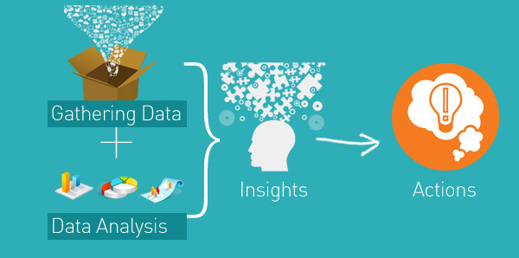
Empowering Insights
Notes:
Example of Sprinkler
Power of connecting Data across disciplines
Democratising the data
--Smart Meter Example
Processing Big Data
Better Decision Making

Slide 14
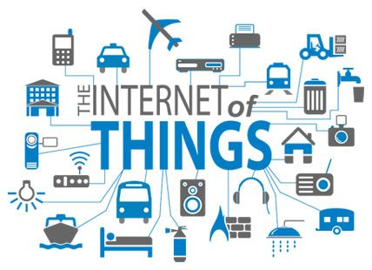
What’s Next?
Notes:
Started with only homes
Smart
grid
Transportation
Cities
Not slowing down
30bn IoT by 2020

Slide 15
Thanks
Notes:
Who will know what someone will discover in the data tomorrow?

